Slide 1
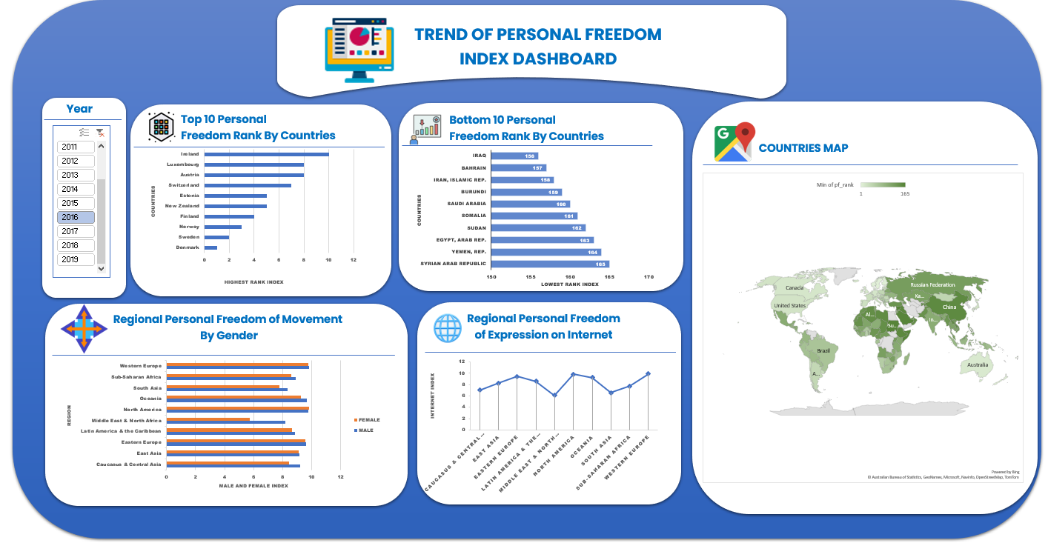
Steps involved in analyzing this project
A database was created in PGAdmin called personal freedom.
The CSV file was converted to SQL format and imported into PGAdmin using the restore command.
The data was cleaned.
The cleaned data was exported to excel.
A pivot table was created used to create charts that will be visualized.

Slide 2
Personal freedom
Personal freedom is the freedom of every law abiding individual in a given country. to think what he will, to express his view freely in line with the law of the residing country, without hindrance from any other individuals.

Slide 3
Steps involved in analyzing this Dataset
Based on the data gotten from the Human Freedom Index, personal freedom of each country was analyzed in line with the following questions.
Which of the countries around the world has the highest and least personal freedom over the years?
Comparing freedom of movement of genders in regions around the world
How personal freedom of expression on the internet has changed over the years in different regions of the world.

Slide 4
Steps involved in analyzing this project
A database was created in POSTGRESSQL(PGAdmin) called personal freedom.
The CSV file was converted to SQL format and imported into PGAdmin using the restore command.
The data was cleaned.
The cleaned data was exported to excel.
A pivot table was created used to create charts for Dashboard.

Slide 5
Recommendations
Based on the analysis, I recommend that those with the intentions to relocate should choose countries with the highest personal freedom(TOP 10). E.g Denmark, Sweden.
Personal freedom should be given utmost importance in different countries.
Everyone should be involved in personal freedom.

